Slide 1


Dynamic Charging of EV using Magnetic Resonance Charging
Presented by
Shrimathi G - 2127220601070
Sanjay Kumar V - 2127220601063
Srinivasan U - 2127220601312

Slide 2

1. Project Area : EV/Embedded Systems/Power Electronics
2. Project Title : Dynamic Charging of EV using Magnetic . Resonance Charging
3. Place of Work : In-house
4. Supervisor Name : Dr. S Arulmozhi
5. Project Group : Batch 5

Slide 3
Motivation
Increased Convenience and Enhanced Efficiency
Efficient use of battery
Sustainability
Energy Management

Slide 4
Literature Survey
PAPER TITLE & AUTHOR | WORK | OUTCOME
Simulation-Based evaluation of dynamic wireless charging systems for electric vehicles | Efficiency, limitations, and future directions | Understanding of efficiencylimiting factors, including misalignment, gap variation, and load fluctuations.
Magnetic Resonance Coupling Modelling for Electric Vehicles Wireless Charging | Discusses resonant inductive coupling in motion | Validates our use of 21kHz magnetic resonance
Smart Wireless Resonant Charging of Electric Vehicles (EV) | Wireless power transfer systems, including coil configuration and materials | Configuration and materials used in real world scenarios
ESP32 & IoT Billing for EVs – ResearchGate | Implementation of ESP32 for vehicle data sync | Supports our use of ESP32 for billing integration
Magnetic Resonance Coupling Modelling for Electric Vehicles Wireless Charging | The feasibility of wireless power transfer for Electric Vehicles by electromagnetic resonance coupling is modelled in this paper. | Wireless energy transfer system reaches the maximum (96%) at the resonant frequency
Notes:
4

Slide 5
Problems Identified and Solutions Suggested
Problem:
Grid Bottleneck: Static charging nodes can’t meet the high current demand of cargo fleets, leading to local grid congestion and queuing delays.
Oversized Batteries: Lack of in-transit charging forces use of large Li-ion packs, increasing vehicle mass, cost, and peak grid load.
Downtime: Plug-in charging causes 1–2 hrs idle time, reducing fleet utilization.
Solution:
Dynamic Wireless Power Transfer (DWPT): Enables ~50% smaller batteries, cutting vehicle cost by ~40%.
High Efficiency: Resonant inductive coupling achieves 80–90% transfer efficiency.
Sustainability: Reduces lithium demand, CO₂ emissions, and e-waste.
Continuous Operation: In-motion charging provides limitless range and maximum logistics throughput.

Slide 6
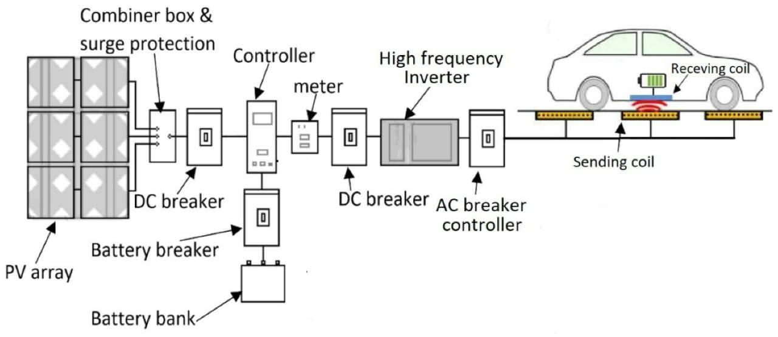
Block Diagram

Slide 7
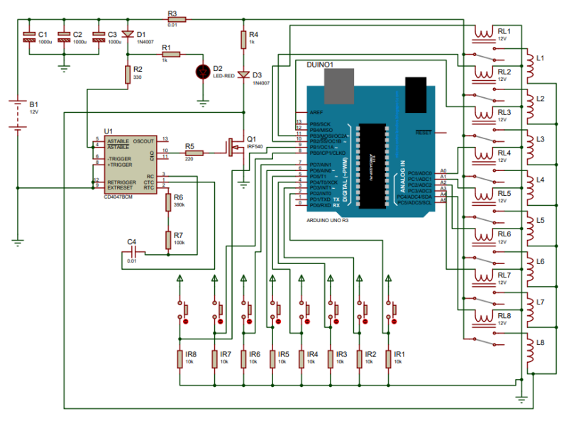
Circuit Design

Slide 8









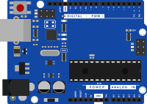



Objectives of the Project
DC
MOSFET
BATTERY
ASTABLE MULTIVIBRATOR
RELAY
CAR DISPLAY
TRANSMITTER COILS
SECONDARY COIL
ARDUINO
IR SENSOR
ESP32
LANE
VEHICLE
SERVER
Develop a DWPT system delivering 80–90% efficient in-motion charging, reducing EV battery size by up to 50%.
To improve the overall efficiency of EV

Slide 9
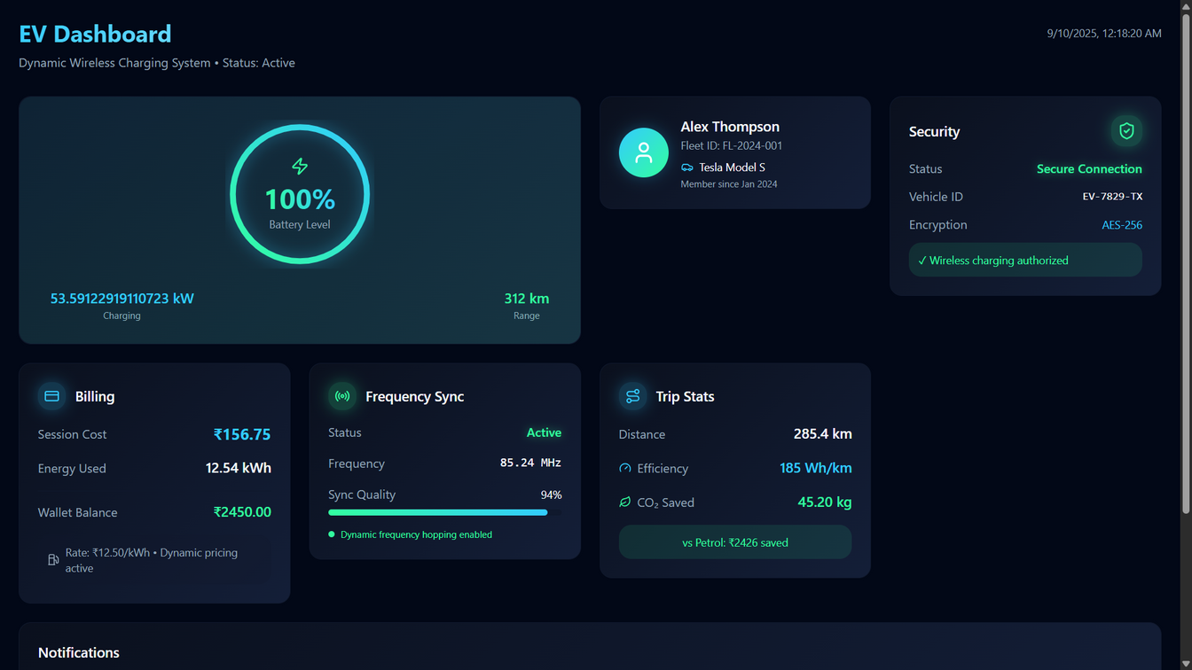

User Dashboard
Devices to Use:
Voltage Measurement:
Hall-Effect Voltage Sensors (isolation, works at high switching frequencies).
Current Measurement:
Rogowski Coil Sensors — excellent for high-frequency currents in coils.
Power/Energy Metering ICs (all-in-one chips):
ADE7753 / ADE9153A (Analog Devices) → industry standard for smart energy metering.

Slide 10
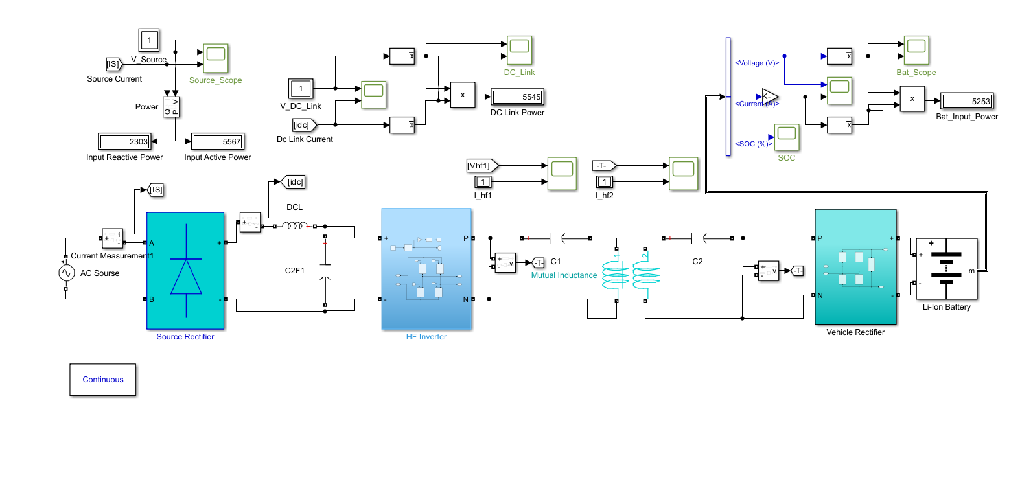
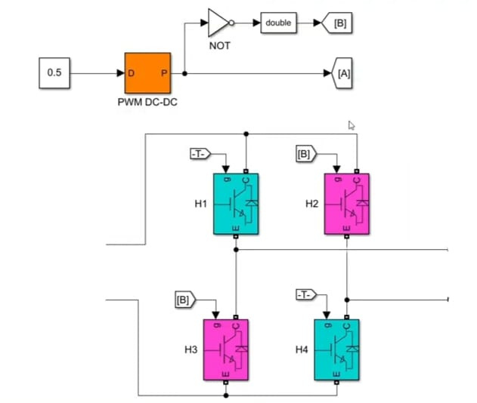
Dynamic wireless charging - simulation
+
-

Slide 11
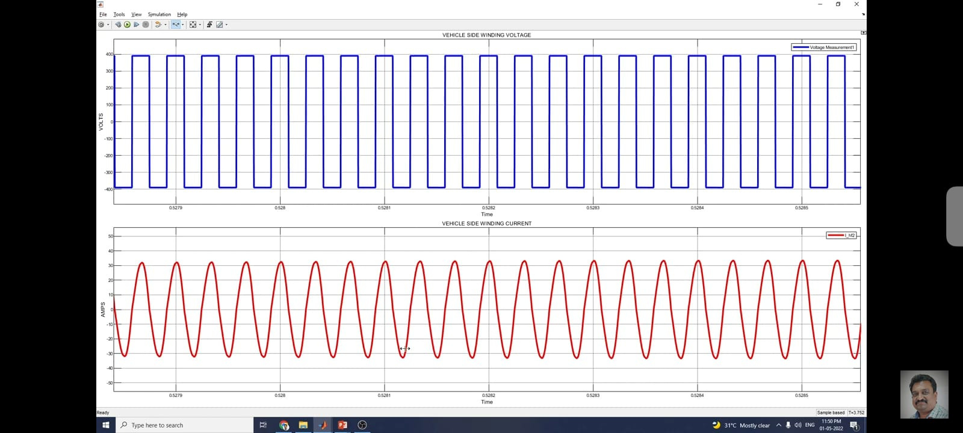
Source side Voltage and Current

Slide 12
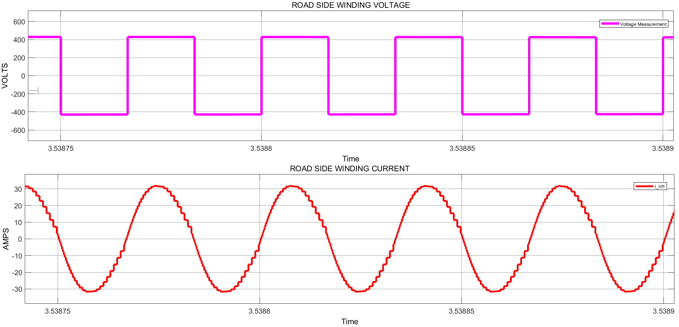
Transmission side Voltage and Current

Slide 13
Plan of Action
 | JULY 2025 | AUGUST 2025 | SEPTEMBER 2025 | OCTOBER 2025
TASK
Literature Survey
Design
Simulation
Hardware Implementation
Report Preparation
Notes:
7

Slide 14

SDG

Slide 15
Feasibility and Cost Analysis
How feasible is wireless transmission?
Proven pilots: Sweden (Gotland, 1.65 km) showed trucks charged while driving with >85% efficiency; Israel (Tel Aviv) and South Korea (Gumi buses) also operate real segments.
Economic studies: Research (KAIST, eRoadArlanda, Electreon pilots) show payback periods of ~5–7 years are possible if deployed at scale, though upfront costs (₹15–30 Cr/km vs ₹10–20 Cr/km for normal roads) are high.
Challenges: High infrastructure cost, standardization, and scaling to highways.
Opportunity: Reduces range anxiety, enables smaller batteries, and increases EV adoption.
Cost analysis
Metro Rail Construction Costs
Elevated Metro: ₹150–300 crore/km
Underground Metro: ₹250–500 crore/km
Example: Bengaluru Metro Phase 3A: ₹776 crore/km Deccan Herald
Dynamic MR Charging Infrastructure Costs
Global Estimate: ~₹16.6 crore/km (based on $2 million/lane-km) Railway Technology
ROI Consideration: Dynamic charging can reduce EV battery size and charging time, potentially lowering operational costs.

Slide 16
References
1. S. Malini, R. R. Hariharan, R. Naveen Kumar, R. Ragul, and S. Vijay Prabhu, “Smart Wireless Resonant Charging of Electric Vehicles (EV),” 2024 10th International Conference on Advanced Computing and Communication Systems (ICACCS), Coimbatore, India, 2024, pp. 919–923, doi: 10.1109/ICACCS60874.2024.10717057
2. Wireless Power Transfer for EVs – IJAREEIE K. Rajkumar, R. Kumar, and S. Praveen, “Wireless Power Transfer for Electric Vehicles Using Resonant Inductive Coupling,” International Journal of Advanced Research in Electrical, Electronics and Instrumentation Engineering, vol. 6, no. 10, pp. 7768–7773, 2017.
3. E. Ayisire, A. El-Shahat, and A. Sharaf,
“Magnetic Resonance Coupling Modelling for Electric Vehicles Wireless Charging,”
in Proc. IEEE Conference on Power Electronics, Georgia Southern University, USA, 2018,
4. Bukya, R., & Mangu, B. (2022). Wireless EV Battery Charging system using circular-square coupled coils with interoperability and misalignments. International Journal of Engineering & Computer Science & Electronics, 14, 6080–6096.
5. A. El-Shahat and E. Ayisire,
“An Adaptive Resonant Inductive Wireless Charging System for Electric Vehicles,” AIMS Energy, vol. 13, no. 2, pp. 345–364, Feb. 2025, doi: 10.3934/energy.2025023.

